Slide 1
DeepFake
ForensicAI
Deepfake Detection for Criminal Investigations
Team Name :
MTech AI
|
Track: Cyber Forensics
Team Members:
-Dhruv Yadav
-Rishabh Narayan
-Harshil Vashita

Slide 2
The Growing Deepfake Crime Crisis
01
02
03
Sextortion + fraud
AI-generated deepfakes at scale
Weeks of FSL backlog
No structured forensic tooling
Legal mapping gap
IT Act 2000 / BNS needs specialists
REFERENCE / Rashmika Mandanna viral deepfake, Nov 2023
FORENSICAI / 02

Slide 3
Why Existing Tools Fail
SIMPLE DETECTOR
DEEPFAKE FORENSICAI
01 Single percentage output only
02 No explanation
03 No legal packaging
04 No audit trail
01 Attention heatmaps
02 Chain of custody
03 IBM Bob brief
04 19-section PDF forensic dossier
FORENSICAI / 03

Slide 4
End-to-End Forensic Architecture
UPLOAD
SHA-256
INGESTION
MEDIA
ROUTER
ViT + MTCNN
Wav2Vec2 + TEMP
FUSION
ENGINE
IBM BOB
19-SECTION
PDF
FastAPI | React 18 | PyTorch | IBM Bob | SHA-256
FORENSICAI / 04

Slide 5
Four Specialized Pre-Trained Neural Networks
01 / VISION
02 / AUDIO
Vision Transformer ViT-Base
Wav2Vec 2.0 Audio
86M params · FaceForensics++ trained
95M params · 16kHz raw waveform · TTS/clone
03 / FACE
04 / TEMPORAL
MTCNN Face Localization
Temporal Aggregation Engine
5-point landmarks · 20% boundary margin
Inter-frame jitter · variance · peak anomaly
FORENSICAI / 05

Slide 6
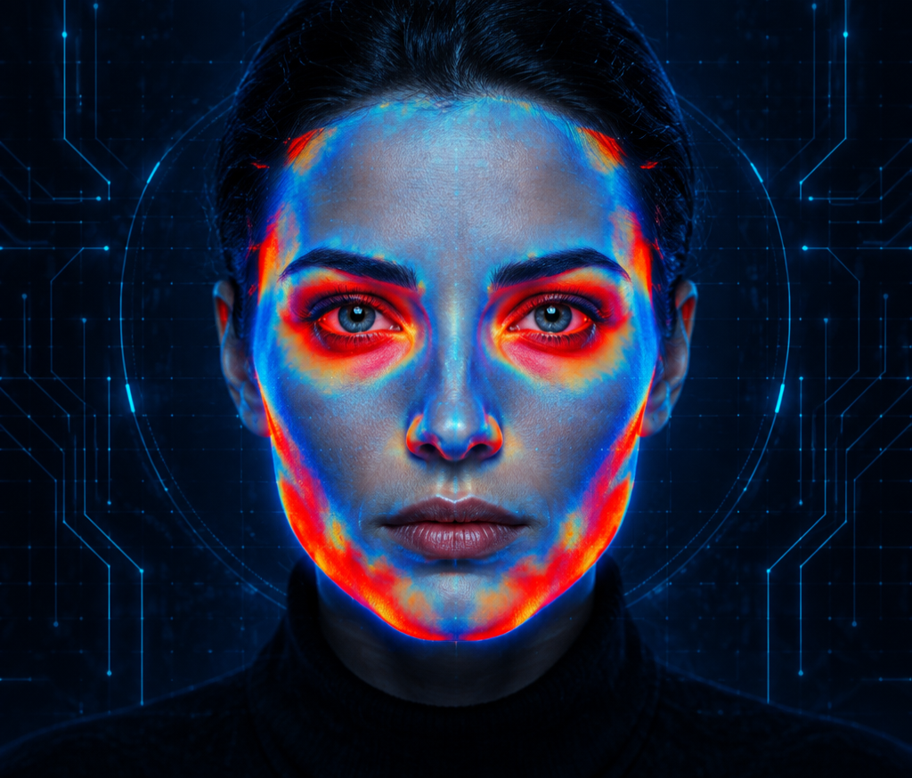
Grad-CAM Attention Heatmaps: WHERE and WHY
01 Self-attention rollout across all 12 ViT encoder blocks
02 14×14 activation grid mapped to face pixel coordinates
03 Highlights boundary seams, texture smoothing, blending artifacts
04 Not a black box — every pixel activation is traceable
FORENSICAI / 06

Slide 7
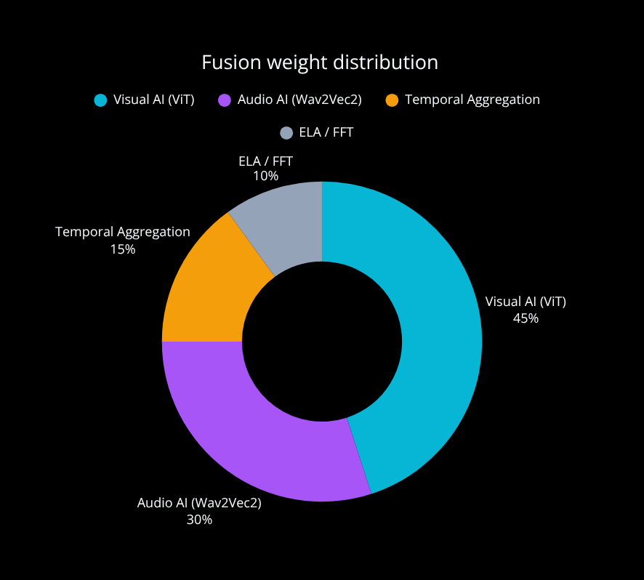
Evidence Fusion: Neural Networks Dominate (85–90% Weight)
45% VISUAL AI / ViT
30% AUDIO AI / Wav2Vec2
15% TEMPORAL AGGREGATION
10% SUPPORTING ELA / FFT
AUTHENTIC <0.45 INCONCLUSIVE 0.45–0.70 POTENTIALLY MANIPULATED >0.70
FORENSICAI / 07

Slide 8
Immutable Block-Linked Forensic Custody Ledger
GENESIS
INGESTION
SHA-256
MODEL
EXECUTION
FUSION
BOB
REPORTING
EXPORT
LOCKED / SHA-256 + MD5 AT INGESTION
LOCKED / TIMESTAMPED MODEL EXECUTIONS
LOCKED / ISO/IEC 27037 COMPLIANCE
LOCKED / FRE 901 / 902 READY
FORENSICAI / 08

Slide 9
IBM Bob: Load-Bearing Forensic Reporting Agent
WHAT BOB RECEIVES
WHAT BOB GENERATES
Evidence package with scores
Heatmap URLs
Custody events
13-section dossier with verdict
Visual / audio / temporal analysis
Conflicting evidence
Recommendations
Custody notes
FAIL-SOFT / Full AI analysis works even when Bob is offline
FORENSICAI / 09

Slide 10
Interactive Q&A Grounded in Evidence — No Hallucination
Q / Why was this file flagged?
A / EV-TEM-001: Facial flickering across 4 frames…
EV-VIS-001: Boundary seam artifact…
Q / What models were used?
A / ViT-Base, MTCNN, Wav2Vec2 + temporal engine.
Every answer cites exact evidence IDs. Bob never fabricates findings.
FORENSICAI / 10

Slide 11
Court-Ready 19-Section Forensic Dossier — One Click Download
CASE ID & PROVENANCE
MEDIA SHA-256
VERDICT & CONFIDENCE
RISK LEVEL
MODEL TABLE
HEATMAP ANALYSIS
FRAME TIMELINE
MULTIMODAL CHANNEL FINDINGS
EVIDENCE TABLE
EVIDENCE DAG
BOB EXECUTIVE BRIEF
LIMITATIONS
CHAIN OF CUSTODY AUDIT LEDGER
SUBMIT TO FSL / COURT / FIR FILING
FORENSICAI / 11

Slide 12
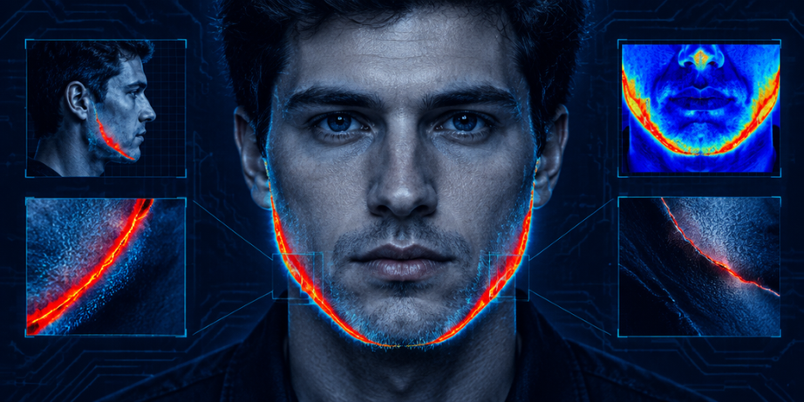
System in Action
IMAGE / PORTRAIT
FAKE 89% CONFIDENCE
Heatmap: boundary seam at jawline
AUDIO / VOICE NOTE
FAKE 91% CONFIDENCE
Wav2Vec2: vocoder phase artifacts
FORENSICAI / 12

Slide 13
Honest Limitations — Probabilistic, Not Absolute
01
No custom foundational model
Public checkpoints
02
CPU inference
60–120s per video
03
Single-user synchronous
No task queue
04
30-frame sampling cap
on video
05
No authentication
or RBAC
06
PDF is not
digitally signed
AI RESULTS AUGMENT — NOT REPLACE — QUALIFIED FORENSIC EXAMINERS
FORENSICAI / 13

Slide 14
What Comes Next
v1.1
v1.2
v2.0
v2.5
Celery / Redis task queue
Concurrent inference
Foundational model
1L+ Indian-context clips
RBAC + officer login
Case assignment workflow
PKCS#7 signing + QR
Offline model bundle
FORENSICAI / 14

Slide 15


DeepFake ForensicAI
From Upload to Court — in One Workflow
Python | FastAPI | PyTorch | React 18 | IBM Bob | SHA-256
MTech AI — Dhruv Yadav | Harshil Vashita | Rishabh Narayan

